Slide 1




NEXT GEN EMPLOYABILITY PROGRAM
Creating a future-ready workforce
Team Members
College Name
Student Name :A.Babisha
Student ID :au960221104038
Arunachala college of engineering women

Slide 2

CAPSTONE PROJECT SHOWCASE
Project Title
Car Rentals Application with Django Framework
Abstract | Problem Statement | Project Overview | Proposed Solution | Technology Used | Modelling & Results | Conclusion

Slide 3
Abstract: 1,The proliferation of car rental services has led to a significant demand for efficient and user-friendly platforms that streamline the process of renting vehicles. In response to this demand, this project aims to develop a comprehensive Car Rentals Application using the Django Framework. 2,The application will provide a seamless experience for both customers and administrators, offering features such as user registration, vehicle browsing, reservation management, and administrative controls. Utilizing Django's built-in authentication system, users will be able to create accounts, log in securely, and manage their rental reservations.
Source :

Slide 4
Problem Statement: The car rental industry has witnessed significant growth in recent years, with an increasing number of people opting for rental services for their transportation needs. However, many existing car rental platforms suffer from inefficiencies, outdated interfaces, and lack of user-friendly features. 1, Inefficient User Experience: Existing car rental platforms often lack intuitive user interfaces 2, Scalability and Performance: The user base grows and the application handles increasing traffic, scalability and performance become critical factors. 3, Limited Functionality: Many car rental platforms offer limited functionality, restricting users' ability to browse vehicles, make reservations, or manage their bookings effectively. 4, Poor Inventory Management: Inefficient inventory management can lead to issues such as overbooking, inaccurate availability information, and difficulty in tracking vehicle status
Source :

Slide 5
Project Overview The Car Rentals Application aims to provide a modern, efficient, and user-friendly platform for renting vehicles, built using the Django Framework. The project will encompass both frontend and backend development to deliver a comprehensive solution that caters to the needs of customers and administrators alike. Key Features are: . User Registration and Authentication . Vehicle Browsing and Filtering . Reservation Management . Inventory Management . Pricing and Payment Processing . Administrative Controls . Responsive Design . Security Measures
Source :

Slide 6
Proposed Solution: The Car Rentals Application will be developed using the Django Framework to provide a robust, scalable, and user-friendly platform for renting vehicles. The solution will encompass both frontend and backend components, offering a comprehensive set of features for customers and administrators. 1-User Management: Users will be able to register accounts securely, providing necessary details such as name, email, and password. Authentication will be handled using Django's built-in authentication system, ensuring secure access to user accounts. User profiles will allow customers to manage their personal information, view booking history, and update preferences. 2-Vehicle Listing and Booking: The application will offer a user-friendly interface for browsing available vehicles, including cars, trucks, and vans. Advanced search and filtering options will enable users to find vehicles based on criteria such as location, type, and price range.
.
Source :

Slide 7
3-Payment Processing: The application will support secure online payments using popular payment gateways, ensuring smooth and reliable transactions. ntegration with payment APIs will enable users to make payments using credit/debit cards, digital wallets, or other payment methods.
4-Administrative Controls: Administrators will have access to a comprehensive dashboard for managing users, vehicles, reservations, and payments. Administrative controls will include features for setting rental policies, managing staff accounts, and configuring system settings.
5-Responsive Design: The frontend interface will be designed using responsive web design principles to ensure compatibility across devices of varying screen sizes and resolutions. Mobile-friendly layouts and touch-friendly interactions will provide a seamless experience for users accessing the application from smartphones and tablets.
6-Security Measures: The application will implement robust security measures to protect user data, including encryption of sensitive information and protection against common web vulnerabilities.
Source :

Slide 8
7-Reservation Management: Administrators will have access to a dashboard for managing reservations, including viewing, modifying, and canceling bookings. Automated notifications will alert users and administrators about upcoming reservations, changes, and cancellations.
The system will enforce business rules, such as rental duration limits and availability constraints, to prevent conflicts and ensure smooth operation.
8-Inventory Management: Administrators will be able to add new vehicles to the inventory, update existing listings, and remove vehicles that are no longer available. Real-time availability tracking will ensure accurate representation of vehicle availability to users.
Inventory management tools will allow administrators to categorize vehicles, set rental rates, and manage special promotions or discounts.
Source :

Slide 9


Technology Used
Front-end
Back-end
Source :

Slide 10
Modelling & Results: Database Schema Design: The database schema will include tables for users, vehicles, reservations, payments, and administrative settings.Relationships between tables will be established using foreign keys to ensure data integrity and efficient querying. Backend Development: Django's ORM (Object-Relational Mapping) will be used to define database models and relationships between them. Frontend Development: HTML templates will be created for rendering dynamic content and forms, using Django's template language to inject data from the backend.
Source :

Slide 11
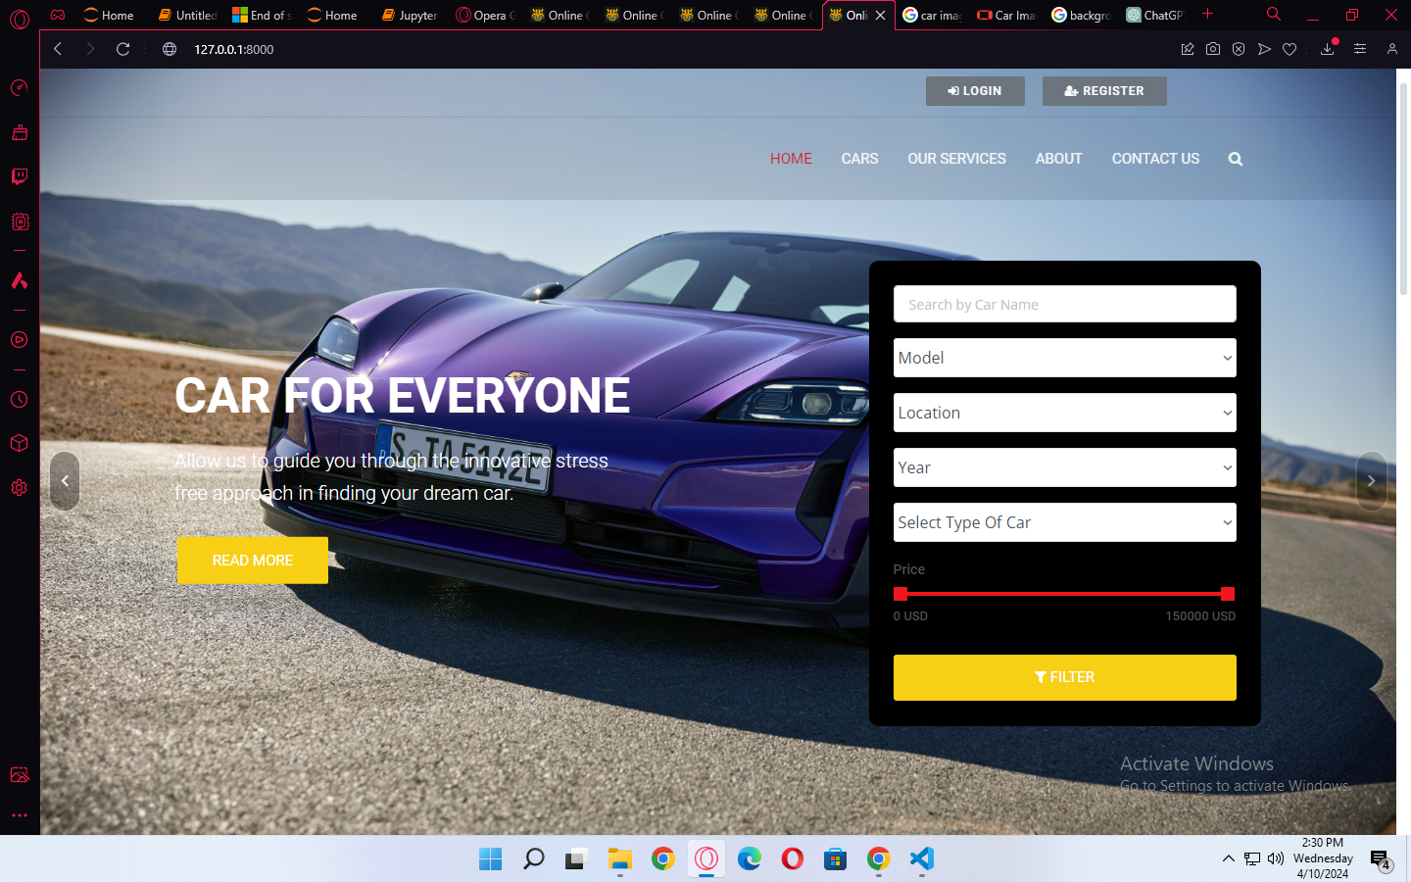
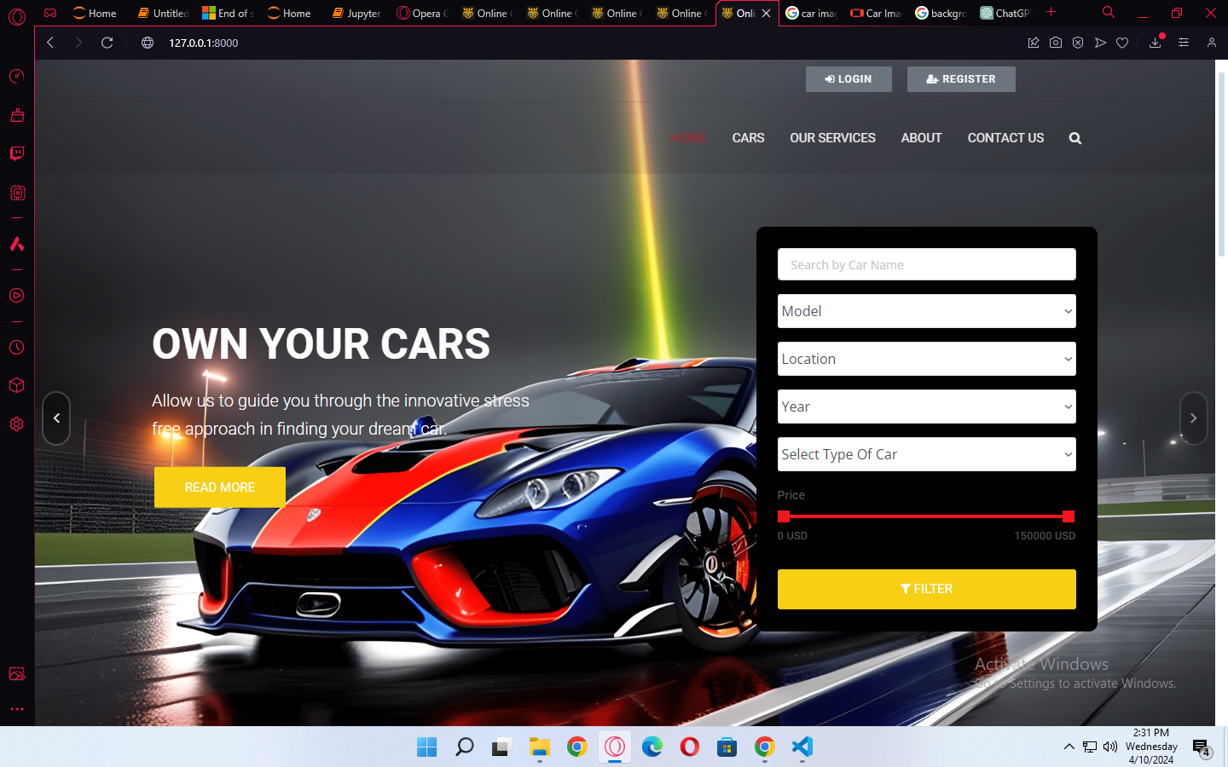
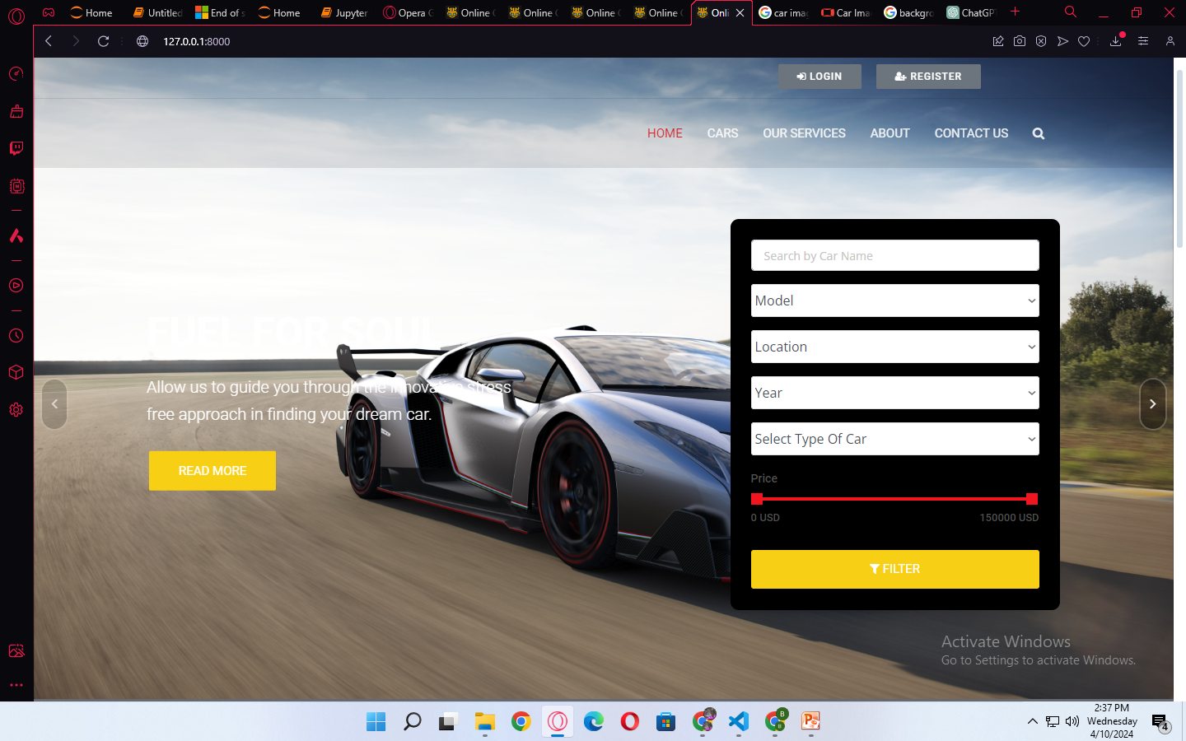
Homepage

Slide 12
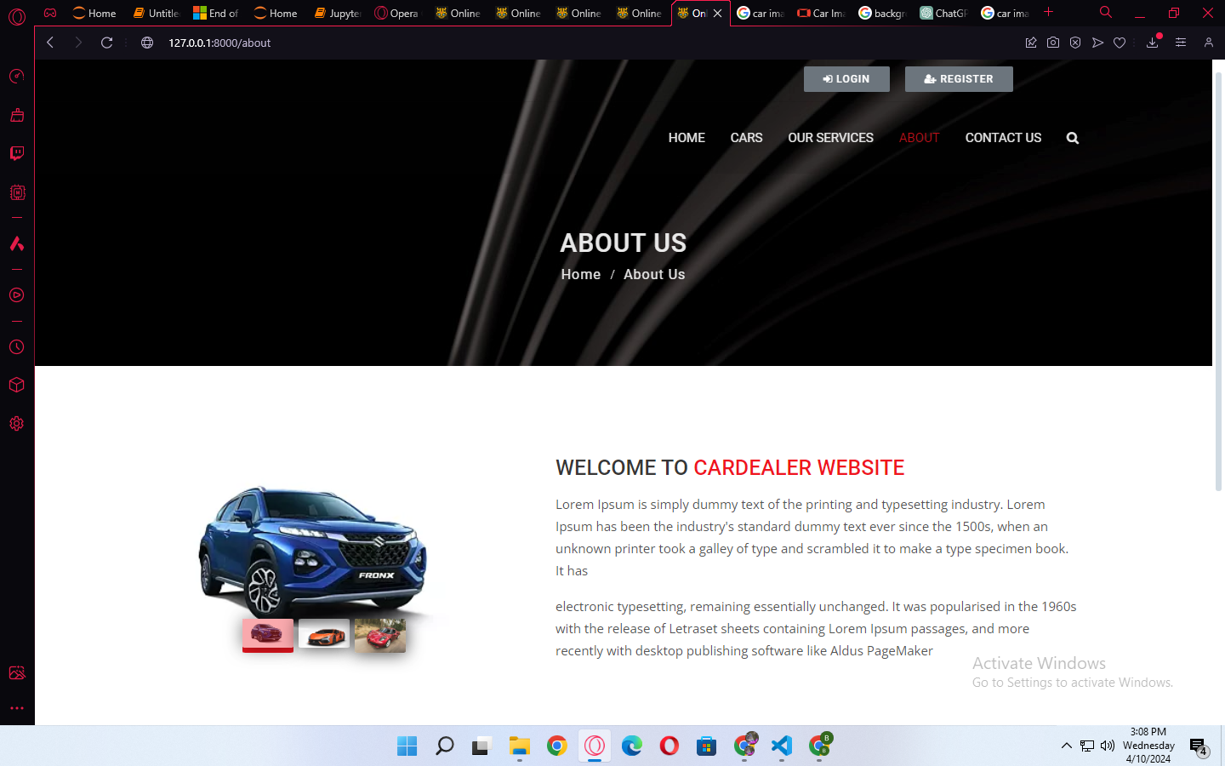
About-Us-Page

Slide 13
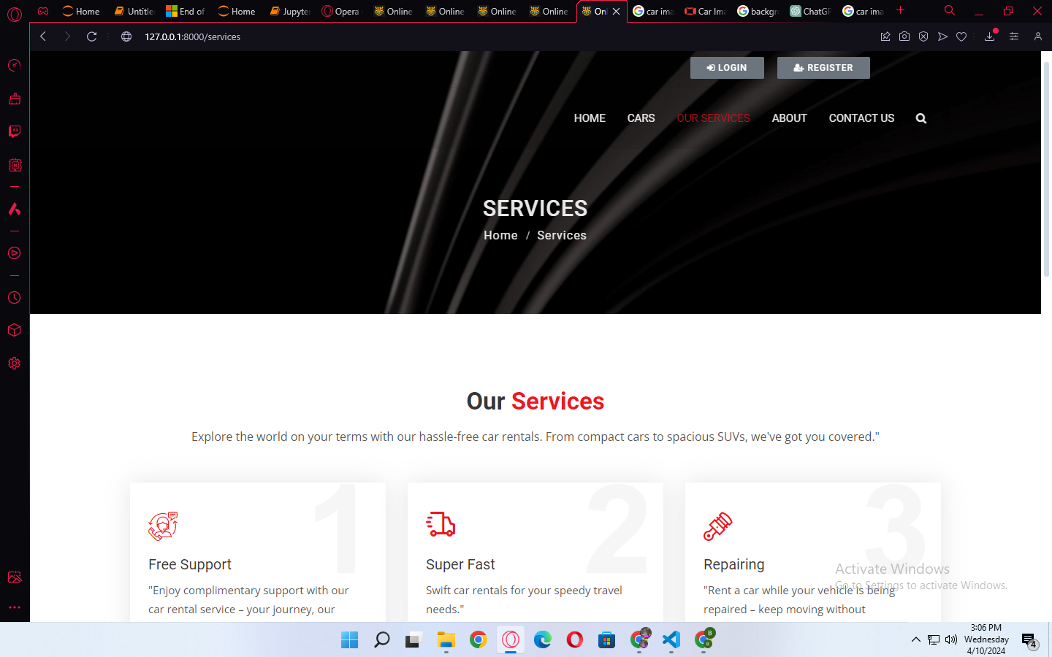
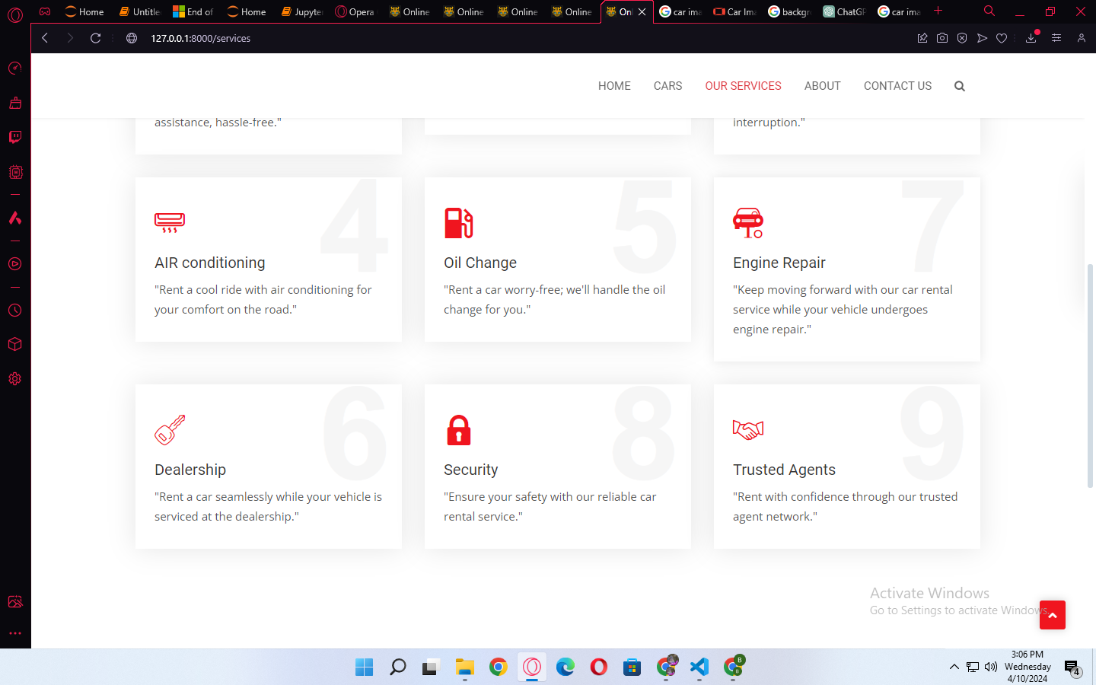
Service-Page

Slide 14
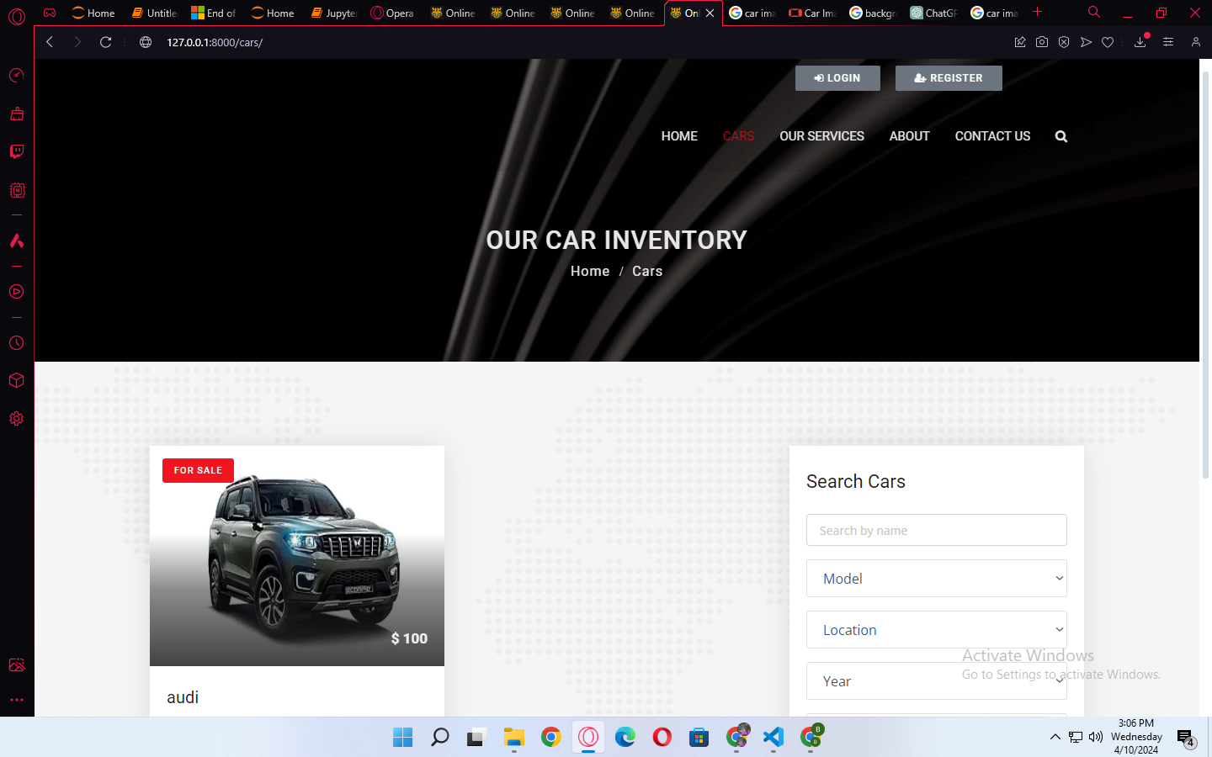
Our car

Slide 15
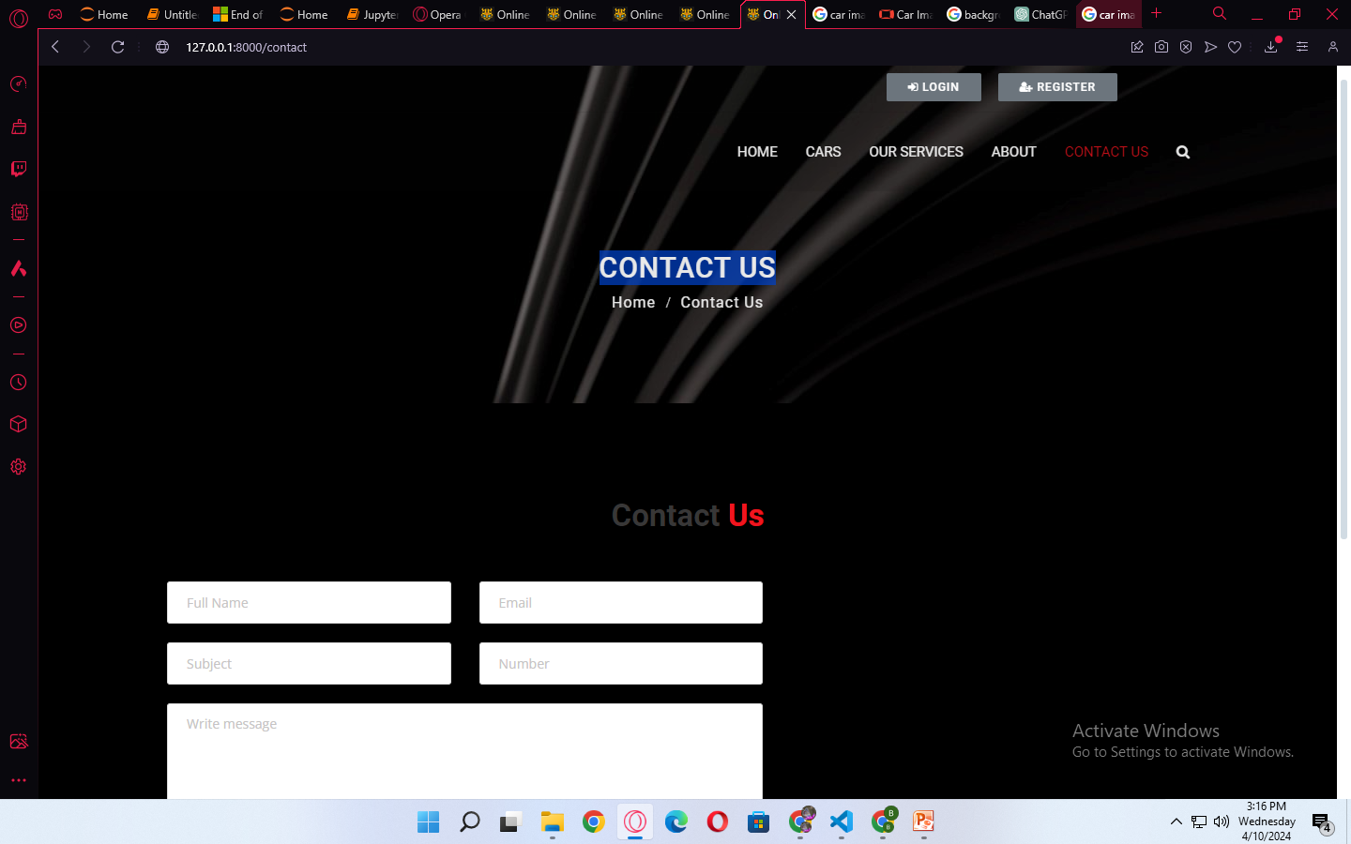
CONTACT US

Slide 16
Future Enhancements: In the ever-evolving landscape of travel and mobility, our commitment to enhancing the car rental experience remains steadfast. Looking ahead, we are dedicated to implementing innovative solutions and cutting-edge technologies to redefine convenience, safety, and sustainability. From seamless digital booking platforms to advanced vehicle features, our future enhancements aim to provide customers with unparalleled flexibility and peace of mind. Whether it's incorporating autonomous driving capabilities or expanding our electric and hybrid fleet options, we're continuously striving to anticipate and meet the evolving needs of our discerning clientele. Embracing the future of mobility, we're excited to embark on this journey with you, ensuring that every rental experience exceeds expectations and paves the way for memorable adventures ahead.

Slide 17
Conclusion: In conclusion, car rental services play a pivotal role in facilitating convenient and flexible travel experiences for individuals and businesses alike. With a diverse range of vehicles, seamless booking processes, and dedicated customer support, renting a car offers freedom and convenience unmatched by other modes of transportation. As technology advances and consumer needs evolve, the future of car rental holds promise for even greater enhancements, ensuring that travelers can continue to rely on these services for safe, efficient, and enjoyable journeys. Whether for leisure or business, renting a car provides the opportunity to explore new destinations, meet deadlines, and create unforgettable memories on the road.
Source :

Slide 18
Thank You!
Notes:
Thank You !!

